Slide 1
Welcome to
Our Sunday School
We’ll start at 9:07
visit OurSundaySchool.com for more about our class

Slide 2
Today’s class (pages 124-128)
Philippians 2:7-8

Slide 3
Philippians 2:7-8 (CSB)
Instead he emptied himself
by assuming the form of a servant,
taking on the likeness of humanity.
And when he had come as a man,
he humbled himself by becoming obedient
to the point of death—
even to death on a cross.

Slide 4
Today’s class (pages 124-128)
Philippians 2:7-8

Slide 5
Deuteronomy 21:22-23
If anyone is found guilty of an offense deserving the death penalty and is executed, and you hang his body on a tree, you are not to leave his corpse on the tree overnight but are to bury him that day, for anyone hung on a tree is under God’s curse. You must not defile the land the Lord your God is giving you as an inheritance.

Slide 6
arbori infelici suspendido
”hang him on the unlucky tree”

Slide 7
Cruciform
cross-shaped

Slide 8
Galatians 3:13
Christ redeemed us from the curse of the law by becoming a curse for us, because it is written, Cursed is everyone who is hung on a tree.

Slide 9
Revelation 22:1-5 (2e-3a)
The leaves of the tree are for healing the nations, and there will no longer be any curse.

Slide 10
Prayer Time
Write down your prayer requests (on the Weekly Update or in the comments)
Lean in, engage, and pray for someone not with you
Go worship

Slide 11
Today’s class (page 16)
Preparing for Philippians 1:1-30
Pray with others
Hear with others
Think with others
Study with others In class, as a table
Share with others
Invite others After class
In class, as a class

Slide 12
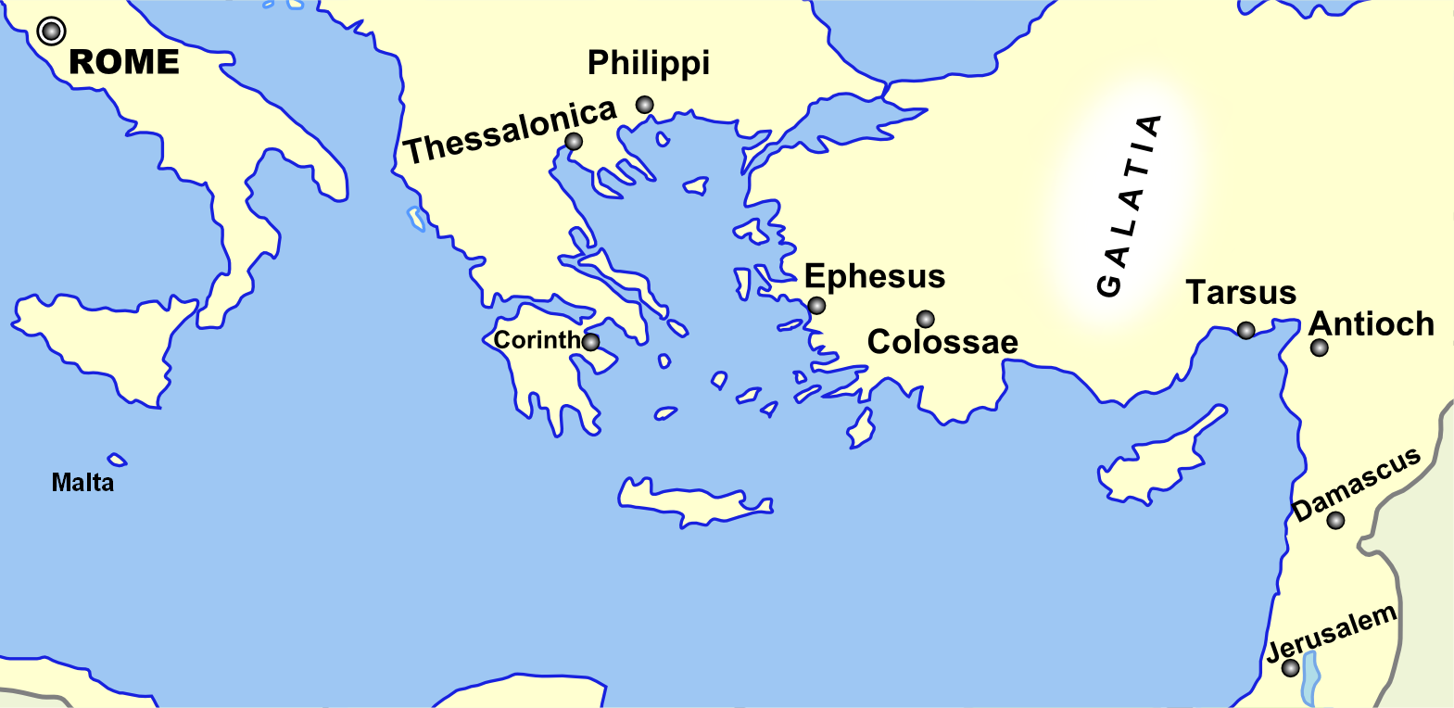
Monozigote. (2012). Broad Overview of Geography Relevant to Paul of Tarsus [Map]. Wikipedia.

Slide 13
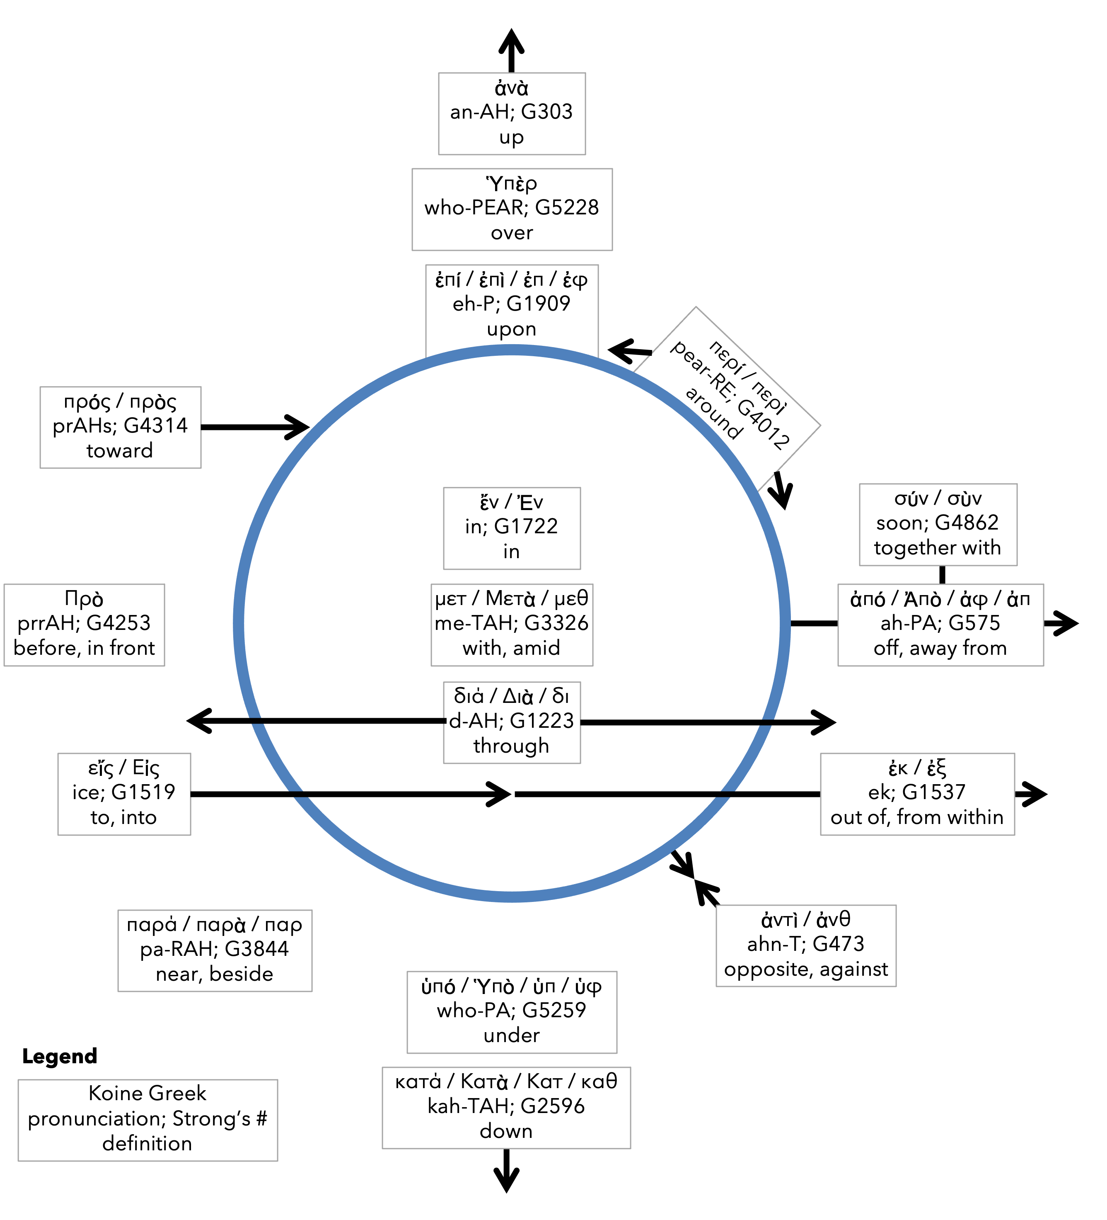
Preposition circle (page 11)

Slide 14
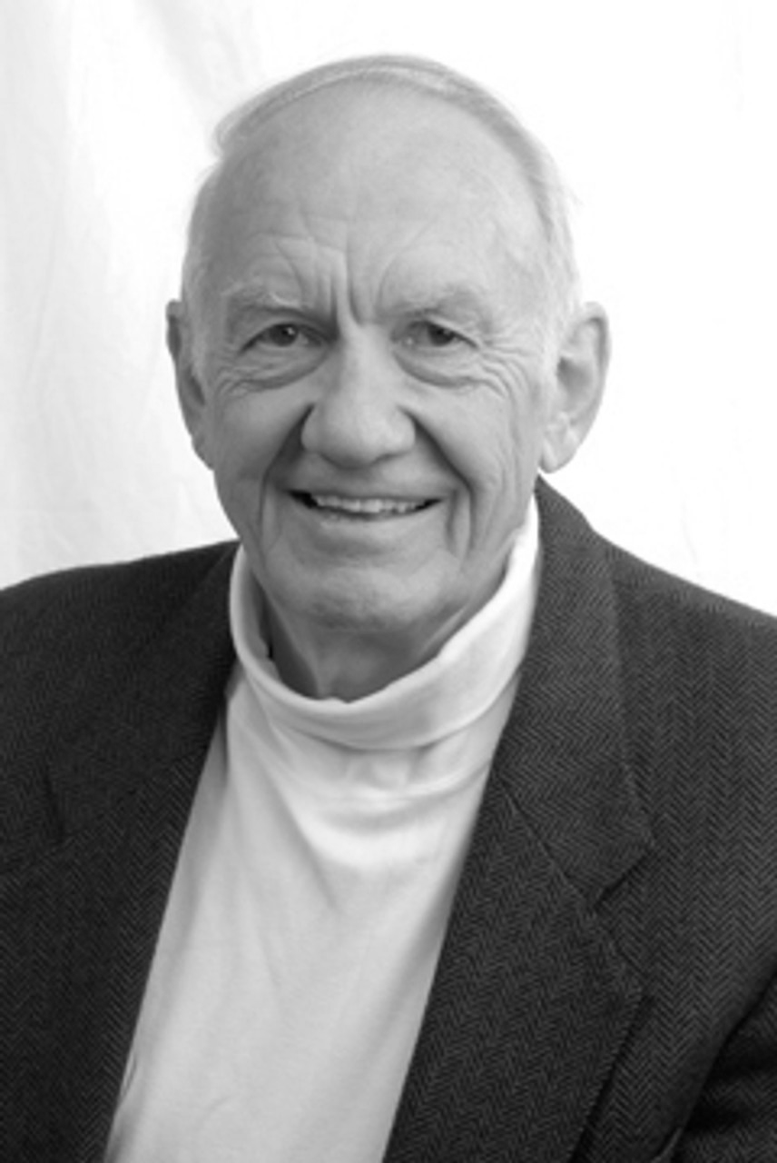
Dr. Gordon Fee Quote

Slide 15
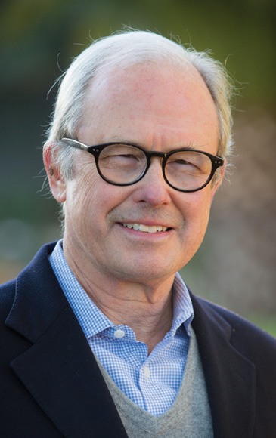
Dr. G. Walter Hansen Quote

Slide 16
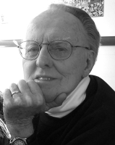
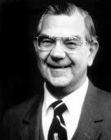
Dr. G. F. Hawthorne & Dr. Ralph P. Martin Quote

Slide 17
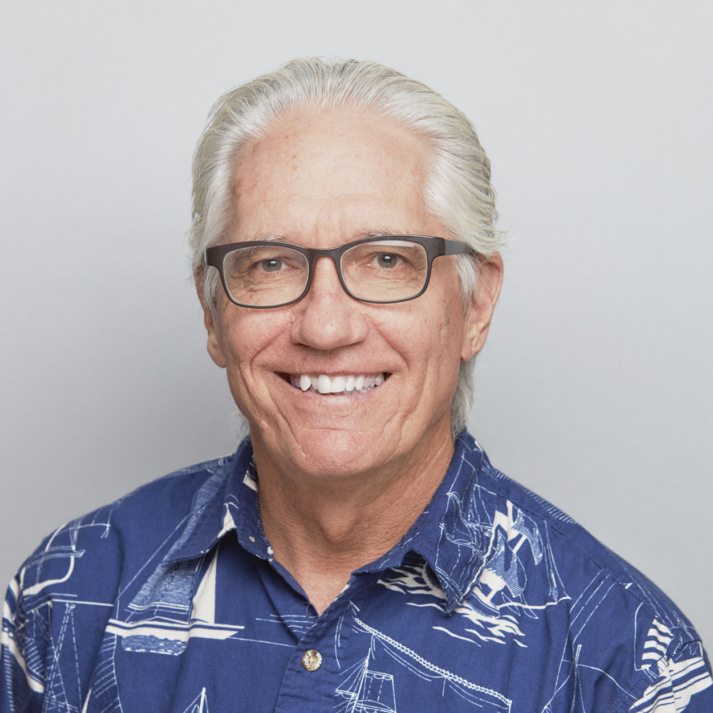
Dr. Joe Hellerman Quote

Slide 18
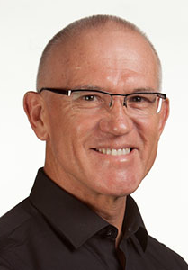
Dr. Mark Keown Quote

Slide 19
Dr. Ralph P. Martin Quote

Slide 20
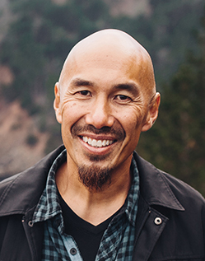
Dr. Tony Merida & Frances Chan Quote

Slide 21
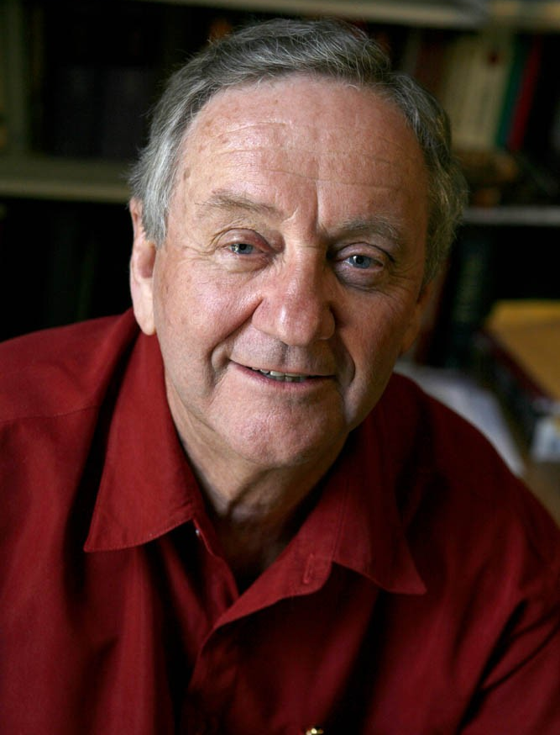
Dr. Peter T. O’Brien Quote

Slide 22
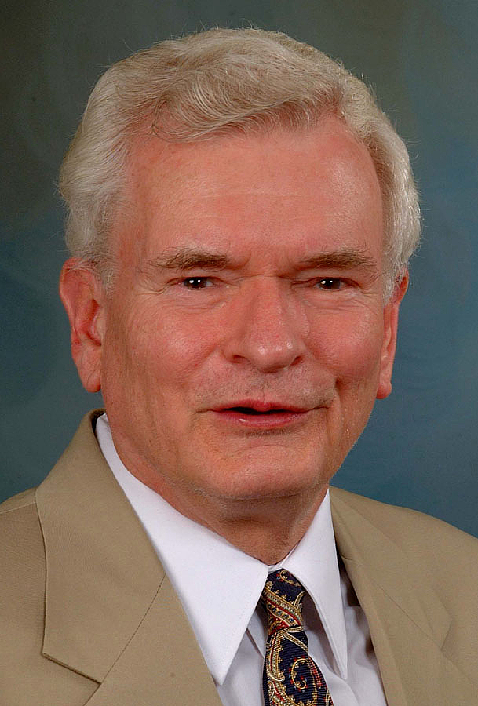
Dr. John Reumann Quote

Slide 23
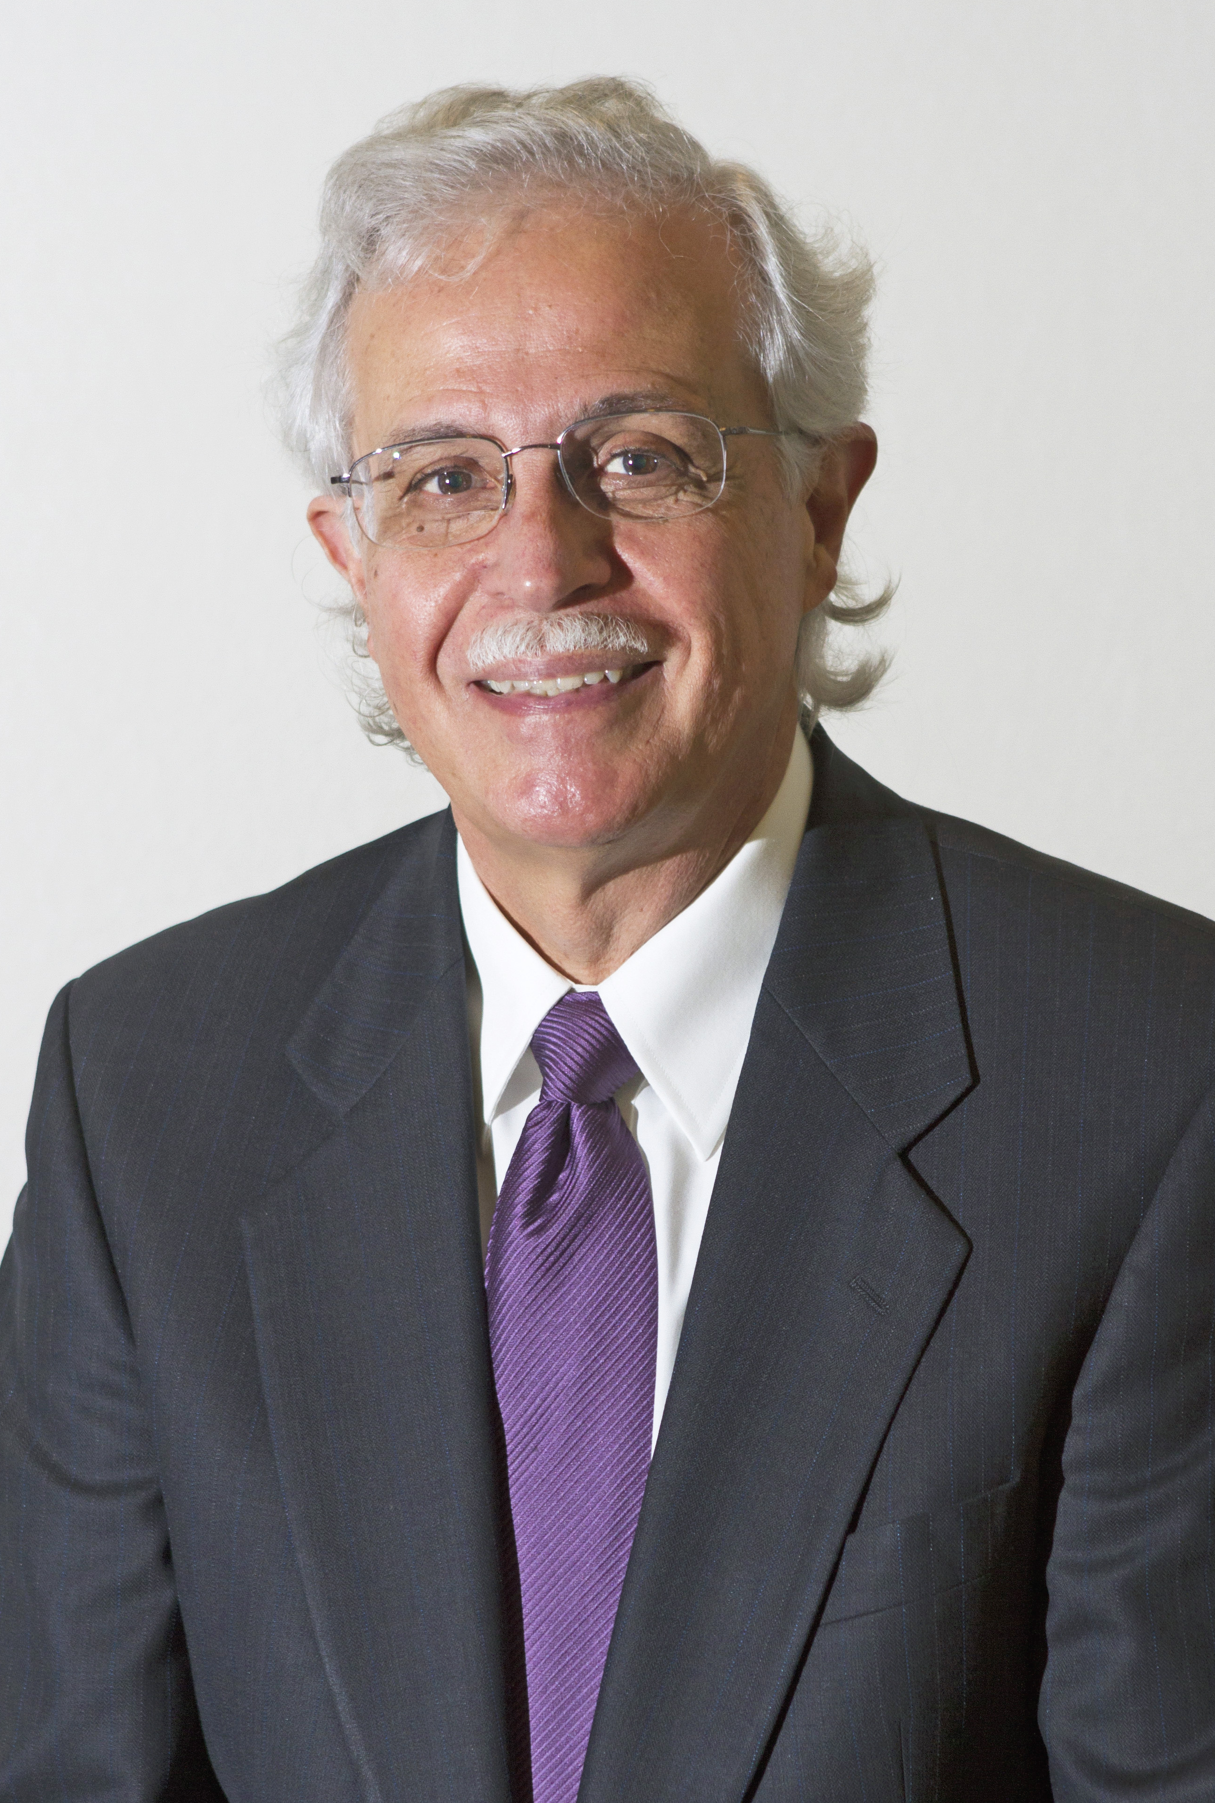
Dr. Moises Silva Quote

Slide 24
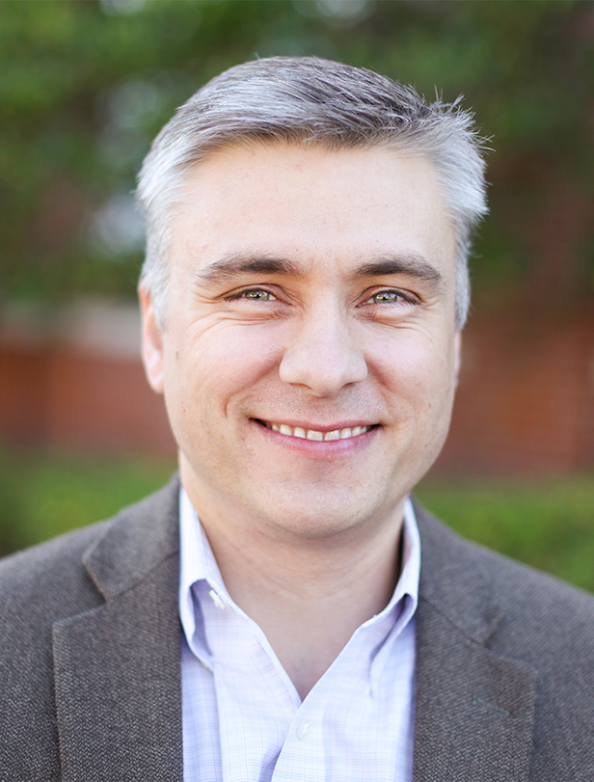
Dr. David T. A. Strain Quote

Slide 25
Jen Wilkin Quote

